Slide 1

SOFTWARE MODELING & DESIGN
SENG-415
Theoretical and practical course, 4 Credits

Slide 2
Blessed assurance, Jesus is mine
O what a foretaste of glory divine
Heir of salvation, purchase of God
Born of His Spirit, washed in His blood
This is my story, this is my song
Praising my Savior all the day long
This is my story, this is my song
Praising my Savior all the day long

Slide 3
Introduction
Software Modeling and Design is the process of creating visual representations of a software system to understand and communicate its design, structure, and behavior.
The main goal of software modeling and design is to simplify complex software systems and make them easier to develop, maintain, and modify.
This course aims to introduce the software engineering process, its tools, skills, and techniques, particularly modeling, validation, and design.
The focus will be on a principled, object-oriented process from requirements modeling and analysis through design, with rolling case studies and coursework examples developing the knowledge and skills.

Slide 4
COURSE CONTENT
Part I
Overview
Part II
Software Modeling
Part III
Architectural Design
Part IV
Case Studies

Slide 5
Content: Part 1 – Overview
Introduction
Overview of UML notation
Software life cycles and processes
Software design and architecture concepts
Overview of software modeling and design method

Slide 6
Content: Part 2 – Software Modeling
Use case modeling
Static modeling
Object and class structuring
Dynamic interaction modeling
Finite state machines and statecharts
State-dependent dynamic interaction modeling

Slide 7
Content: Part 3 – Architectural Design
Overview of software architecture
Software subsystem architectural design
Designing object-oriented software architectures
Designing client/server software architectures
Designing service-oriented architectures
State-dependent dynamic interaction modeling
Designing concurrent and real-time software architectures
Designing software product line architectures
Software quality attributes

Slide 8
Content: Part 4 – Case Studies
Client/server software architecture case study: banking system
Service-oriented architecture case study: online shopping system
Component-based software architecture case study: emergency monitoring system
Real-time software architecture case study: automated guided vehicle system

Slide 9
Content: Part 1 – Overview

Slide 10
Overview → UML Notation
UML (Unified Modeling Language) is a standard language for specifying, visualizing, constructing, and documenting the artifacts of software systems.
UML was created by the Object Management Group (OMG) and UML 1.0 specification draft was proposed to the OMG in January 1997.
It was initially started to capture the behavior of complex software and non-software system and now it has become an OMG standard.

Slide 11
Overview → UML Notation
UML provides a set of graphical notations for describing various aspects of a software system, such as:
Class diagrams: Show the classes, their attributes and methods, and their relationships.
Object diagrams: Show instances of classes and their relationships.
Use case diagrams: Show the actors, their goals, and the interactions between them and the system.
Sequence diagrams: Show the order of messages exchanged between objects.
State machine diagrams: Show the states and transitions of objects and the events that trigger the transitions.
Activity diagrams: Show the flow of activities performed by objects.
Component diagrams: Show the components and the relationships between them.
Deployment diagrams: Show the hardware components and the relationships between them.

Slide 12
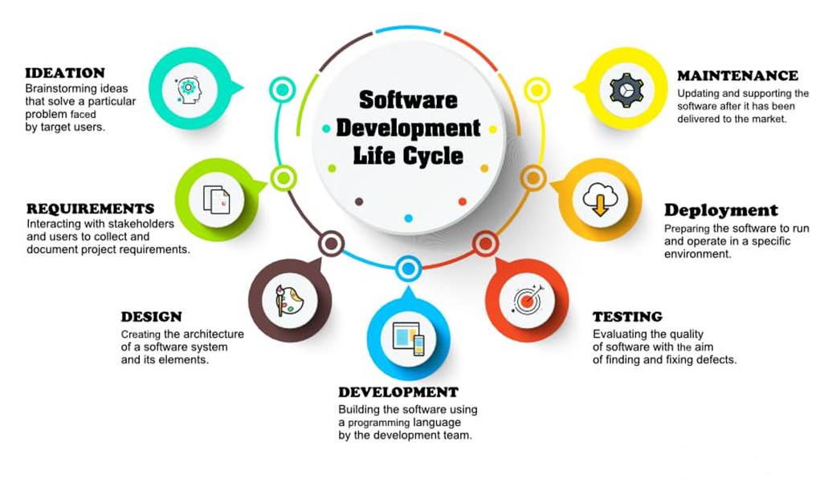
Software Development Life Cycle (SDLC)
Software life cycle (SLC) is a series of stages that a software product or system goes through during its development, from conception to retirement.
The specific stages and processes of a software life cycle can vary depending on the methodology used, but generally, the following stages are common:
Requirements gathering and analysis
Design
Implementation
Testing
Deployment
Maintenance
Retirement

Slide 13
Software Architecture & Design
The architecture of a system describes its major components, their relationships (structures), and how they interact with each other.
Software architecture and design includes several contributory factors such as Business strategy, quality attributes, human dynamics, design, and IT environment.
We can segregate Software Architecture and Design into two distinct phases: Software Architecture and Software Design.
In Architecture, nonfunctional decisions are cast and separated by the functional requirements.
In Design, functional requirements are accomplished.

Slide 14
Software Architecture
Architecture serves as a blueprint for a system. It provides an abstraction to manage the system complexity and establish a communication and coordination mechanism among components.
It defines a structured solution to meet all the technical and operational requirements, while optimizing the common quality attributes like performance and security.

Slide 15
Software Design
Software design provides a design plan that describes the elements of a system, how they fit, and work together to fulfill the requirement of the system. The objectives of having a design plan are as follows −
To negotiate system requirements, and to set expectations with customers, marketing, and management personnel.
Act as a blueprint during the development process.
Guide the implementation tasks, including detailed design, coding, integration, and testing.
It comes before the detailed design, coding, integration, and testing and after the domain analysis, requirements analysis, and risk analysis.

Slide 16
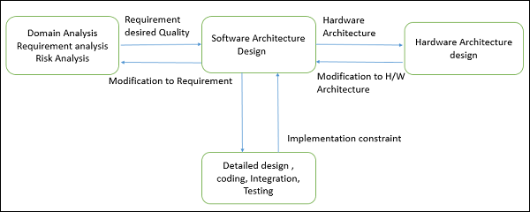
Software Design

Slide 17
Software modeling and design method
Software modeling and design methods are techniques used to represent and plan the development of software systems. Some commonly used methods include:
Object-Oriented Modeling: based on objects and classes, used to model complex systems through inheritance, encapsulation, and polymorphism.
UML (Unified Modeling Language): a visual language used to model software systems and processes through diagrams like class diagrams, sequence diagrams, and state diagrams.
Agile Modeling: an iterative and incremental approach that emphasizes collaboration, flexibility, and adaptability in software development.
Waterfall Model: a linear sequential approach, where each stage must be completed before moving to the next stage of development.
Component-Based Development: a modular approach, where the system is divided into reusable components to ease development, maintenance, and evolution of the system.
Choosing the right method depends on the specific needs and constraints of the software project.

Slide 18
Content: Part 2 – Software Modeling

Slide 19
Part 2 – Software Modeling
Software Modeling and Design is the process of creating visual representations of a software system to understand and communicate its design, structure, and behavior.
The main goal of software modeling and design is to simplify complex software systems and make them easier to develop, maintain, and modify.
Software modeling can be considered from different perspectives, which are referred to as different views.
Use case view
Static view
Dynamic interaction view
Finite state machines and state charts view
State-dependent dynamic interaction modeling
Deployment view

Slide 20
Use Case Modeling
Use case modeling is a software modeling technique that represents the functionality of a system by identifying and describing how actors (users or systems) interact with the system to achieve specific goals.
Use case modeling helps to identify the functional requirements of a system, and serves as a bridge between the requirements and the design of the system.
It provides a clear and concise description of the system's behavior and enables stakeholders to better understand the system's capabilities and limitations.

Slide 21
Use case Model
In the Unified Modeling Language (UML), a use case diagram can summarize the system’s users’ interactions with the system.
A use case model is comprised of a set of use cases, each of which represents a specific function or feature of the system.
An effective use case diagram helps to discuss and represent:
Scenarios in which the system interacts with people, organizations, or external systems
Goals that the system helps those entities (known as actors) achieve
The scope of the system

Slide 22
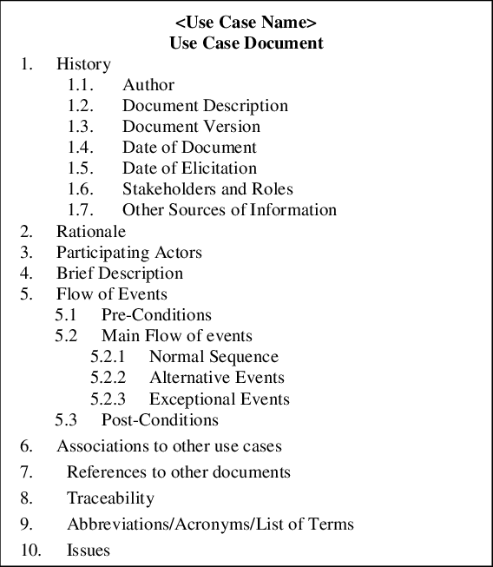
Use Case Concept
The concept comprises two approaches that can be used together:
Specifications: Use Case Specifications contain natural-language information on the systematics of the interactions of an application case (so-called “narratives”). Ideally, this information is captured textually using a template.

Slide 23
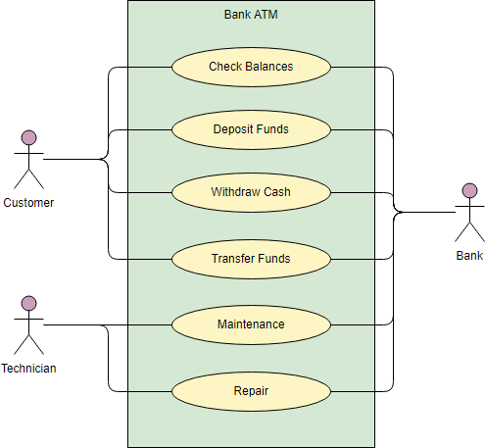
Use Case Concept (Cont’d)
Diagrams: Use Case Diagrams visualize Use Cases and actors with their respective relationships. Use Case Diagrams are regarded as graphical representations of Use Cases and the Unified Modeling Language (UML) defines them as behavior diagrams. The most important model elements here are: Actors, Use Cases, Relationships and System boundaries.

Slide 24
Use Case Diagram
To create a use case diagram, you can follow these steps:
Identify actors: Identify the actors involved in the system being modeled. Actors can be users, external systems, or other entities that interact with the system.
Define use cases: Identify the actions or functions that actors can perform within the system. Each action should be described as a specific use case.
Draw the diagram: Use a UML modeling tool to draw the use case diagram. The diagram should consist of:
Actor symbols: Representing the actors identified in step 1.
Use case symbols: Representing the use cases defined in step 2.
Connectors: Used to connect actors to the use cases they participate in.
Add details: Add additional details to the use case symbols such as preconditions, post-conditions, and alternate flows.
Review and refine: Review the diagram to make sure it accurately represents the system and the interactions between actors and use cases. Refine the diagram as necessary.

Slide 25
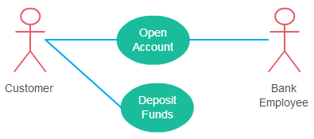
Relationships in use-case diagrams
In UML, a relationship is a connection between model elements.
There can be 5 relationship types in a use case diagram:
Association between actor and use case
An actor must be associated with at least one use case.
An actor can be associated with multiple use cases.
Multiple actors can be associated with a single use case

Slide 26
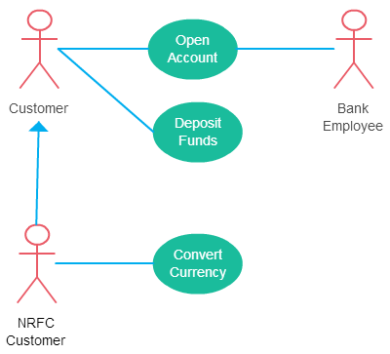
Relationships in use-case diagrams (Cont’d)
Generalization of an Actor: Generalization of an actor means that one actor can inherit the role of the other actor. The descendant inherits all the use cases of the ancestor. The descendant has one or more use cases that are specific to that role. Let’s expand the previous use case diagram to show the generalization of an actor.

Slide 27
Relationships in use-case diagrams (Cont’d)
Extend Relationship Between Two Use Cases: Many people confuse the extend relationship in use cases. As the name implies it extends the base use case and adds more functionality to the system. Here are a few things to consider when using the <<extend>> relationship..
The extending use case is dependent on the extended (base) use case. In the below diagram the “Calculate Bonus” use case doesn’t make much sense without the “Deposit Funds” use case.
The extending use case is usually optional and can be triggered conditionally. In the diagram, you can see that the extending use case is triggered only for deposits over 10,000 or when the age is over 55.
The extended (base) use case must be meaningful on its own. This means it should be independent and must not rely on the behavior of the extending use case.

Slide 28
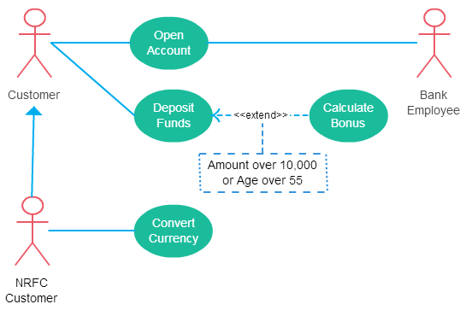
Relationships in use-case diagrams (Cont’d)

Slide 29
Relationships in use-case diagrams (Cont’d)
Include Relationship Between Two Use Cases: Include relationship show that the behavior of the included use case is part of the including (base) use case. The main reason for this is to reuse common actions across multiple use cases. In some situations, this is done to simplify complex behaviors. Few things to consider when using the <<include>> relationship.
The base use case is incomplete without the included use case.
The included use case is mandatory and not optional.

Slide 30
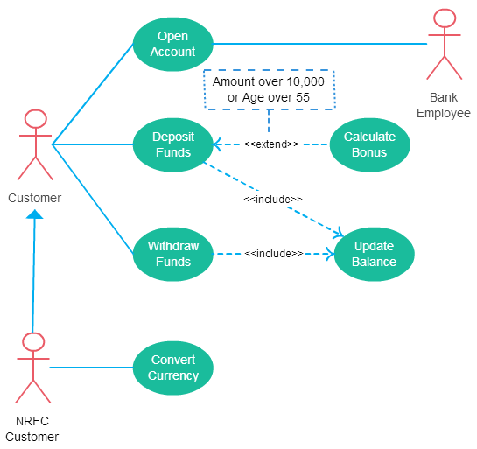
Relationships in use-case diagrams (Cont’d)

Slide 31
Relationships in use-case diagrams (Cont’d)
Generalization of a Use Case: This is similar to the generalization of an actor. The behavior of the ancestor is inherited by the descendant. This is used when there is common behavior between two use cases and also specialized behavior specific to each use case.
For example, in the previous banking example, there might be a use case called “Pay Bills”. This can be generalized to “Pay by Credit Card”, “Pay by Bank Balance” etc.

Slide 32
Part 2 – Software Modeling
Software Modeling and Design is the process of creating visual representations of a software system to understand and communicate its design, structure, and behavior.
The main goal of software modeling and design is to simplify complex software systems and make them easier to develop, maintain, and modify.
Software modeling can be considered from different perspectives, which are referred to as different views.
Use case view
Static view
Dynamic interaction view
Finite state machines and state charts view
State-dependent dynamic interaction modeling
Deployment view

Slide 33
Static Modeling
Static modeling is a modeling technique used in software engineering to represent the structure of a system, application, or process.
It involves creating diagrams or models that show the relationships, components, and attributes of the system being modeled, without considering the behavior or changes over time.
Static modeling is a key step in the software development process, providing a clear and concise understanding of the system structure and design, which helps to ensure that the implementation accurately reflects the intended design.

Slide 34
Static Modeling
Some common techniques for static modeling in software engineering include:
Class diagrams: These diagrams show the classes, objects, attributes, and relationships in an object-oriented system.
Entity-relationship diagrams (ERDs): ERDs are used to model the relationships between entities in a database or system.
Object diagrams: Object diagrams show the objects, attributes, and relationships in a system at a particular point in time.
Component diagrams: Component diagrams show the components of a system and the relationships between them.
Package diagrams: Package diagrams show the packages and dependencies in a system.

Slide 35
Class Diagrams
At the heart of any object-oriented system is the step of designing the class structure – therefore the saying goes that class diagrams are the most popular out of the UML diagram types.
A class diagram is a type of diagram in the Unified Modeling Language (UML) that shows the structure of a system by modeling its classes, their attributes and methods, and the relationships between them.
It is a static representation of the system's structure, focusing on the classes and their relationships rather than the dynamic behavior of the system.
Class diagrams are used for visualizing, describing, and documenting different aspects of a system so that you can construct executable code for software applications.

Slide 36
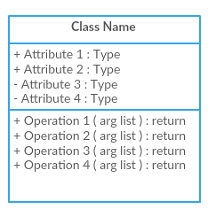
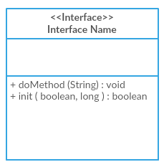
Class Diagram Notations with Examples
In a class diagram, a class is represented as a rectangle with three compartments:
the top compartment shows the class name,
the middle compartment shows the class attributes,
and the bottom compartment shows the class methods.
The relationships between classes are represented by lines between the classes, with arrows showing the direction of the relationship.
The last two compartments are optional. The class notation without the last two compartments is called a simple class and it only contains the name of the class.

Slide 37
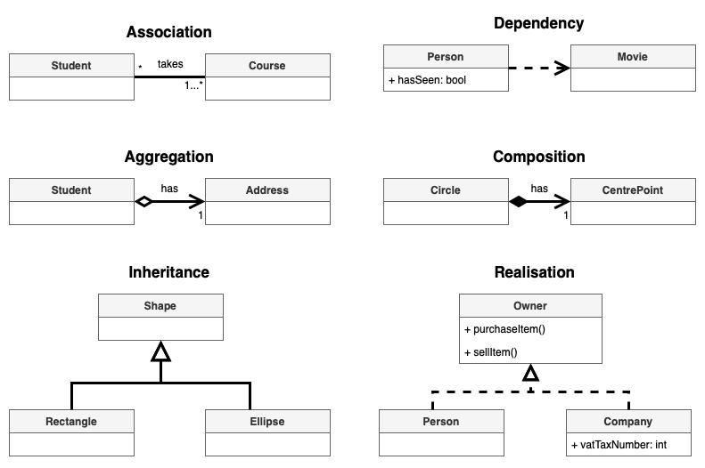
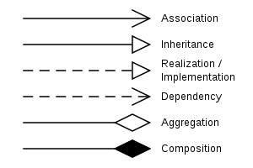
Class Diagram Relationships

Slide 38
Class Diagrams Exercise 1. University
In a university there are different classrooms, offices and departments. A department has a name and it contains many offices. A person working at the university has a unique ID and can be a professor or an employee.
A professor can be a full, associate or assistant professor and he/she is enrolled in one department.
Offices and classrooms have a number ID, and a classroom has a number of seats.
Every employee works in an office.

Slide 39
Class Diagrams Exercise 2. Movie- Shop
Design a system for a movie-shop, in order to handle ordering of movies and browsing of the catalogue of the store, and user subscriptions with rechargeable cards.
Only subscribers are allowed hiring movies with their own card.
Credit is updated on the card during rent operations.
Both users and subscribers can buy a movie and their data are saved in the related order.
When a movie is not available it is ordered .

Slide 40
Object diagrams
An object diagram is a graphical representation of a system that shows a collection of objects and their relationships to each other at a particular moment in time.
It is a type of structural diagram that is commonly used in software engineering and other fields to visualize the objects in a system and how they interact with each other.

Slide 41
Object diagrams
In an object diagram, each object is represented as a box with its name and class type written inside. The objects are connected by lines to show their relationships, which can be inheritance, composition, aggregation, or association. The object diagram also shows the values of the object's attributes and the operations it can perform.
Object diagrams are useful for understanding the structure of a system and the relationships between its objects. They can also be used to test and validate the design of a system and to communicate its structure to stakeholders.

Slide 42
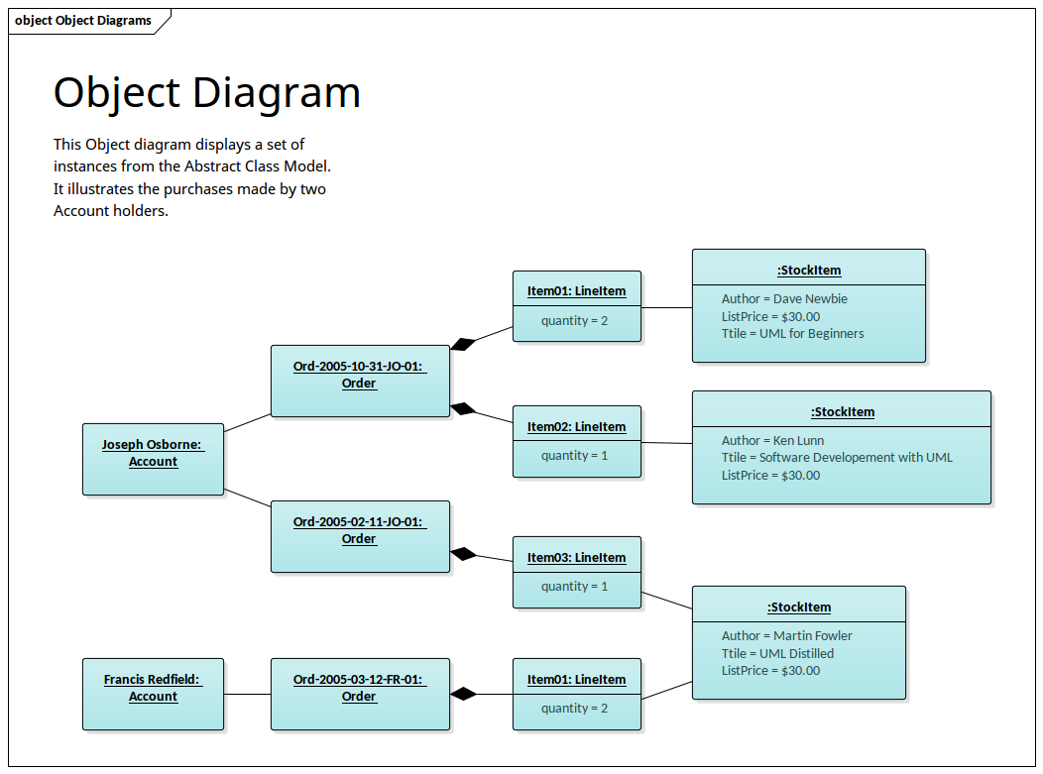

Slide 43
Component diagrams
A component diagram is a type of structural diagram in UML (Unified Modeling Language) that shows the components of a system, their dependencies, and the interfaces that connect them.
A component is a modular, self-contained, and replaceable part of a system that provides a specific function.
In a component diagram, components are represented as rectangles with their name and stereotype (such as "interface" or "class") written inside.
The components are connected by dependencies, which show the relationships between them. The dependencies can be of different types, such as inheritance, realization, association, or usage.

Slide 44
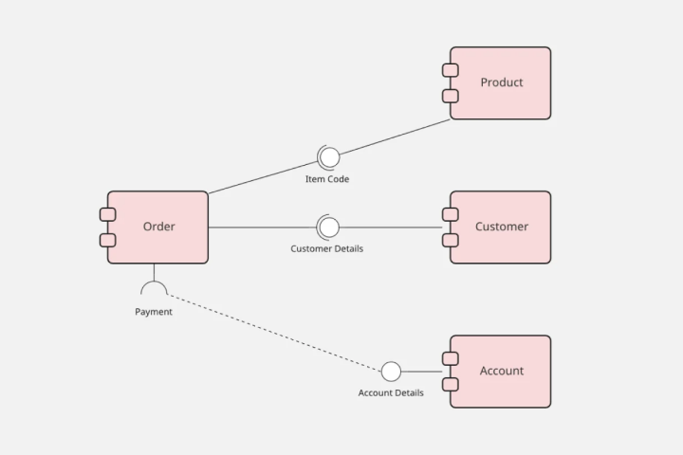
Component diagrams
In addition to components, a component diagram can also show interfaces, ports, and connectors. Interfaces define the methods and properties that a component provides or expects to receive.
Ports are points of interaction between a component and its environment, and connectors are the communication paths between components through which data flows.

Slide 45
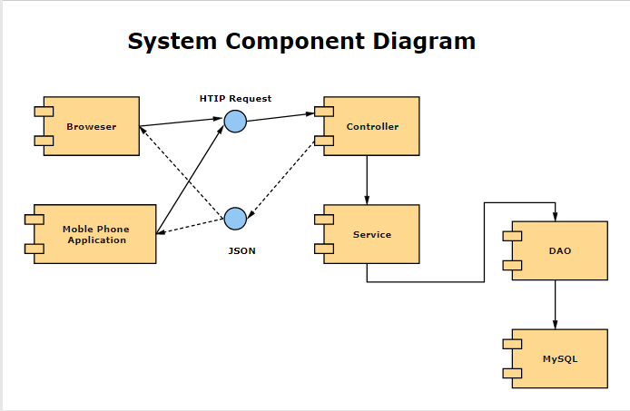
Component diagrams
Component diagrams are useful for visualizing the structure of a system and the dependencies between its components.
They help to identify the modularization of a system and the interfaces that enable components to interact with each other.
Component diagrams are also useful for analyzing the impact of changes to a system's components or interfaces.

Slide 46
Package diagrams
A package diagram is a type of structural diagram in UML (Unified Modeling Language) that shows the organization of the elements of a system into packages, and the dependencies and relationships between these packages.
A package is a grouping of related elements, such as classes, interfaces, and other packages.
In a package diagram, packages are represented as rectangles with their name written inside.

Slide 47
Package diagrams
The packages are connected by dependencies, which show the relationships between them. The dependencies can be of different types, such as generalization, realization, association, or import.
In addition to packages, a package diagram can also show the elements inside the packages, such as classes, interfaces, and other packages.
These elements are represented as rectangles inside the packages.
The package diagram also shows the visibility and access levels of the elements.

Slide 48
Package diagrams
Package diagrams are useful for organizing and managing the complexity of a system.
They help to create a modular structure for the system, which makes it easier to manage and understand.
Package diagrams also help to identify dependencies and relationships between packages, and to ensure that these relationships are properly managed.
They are also useful for identifying components that can be reused in other systems.

Slide 49
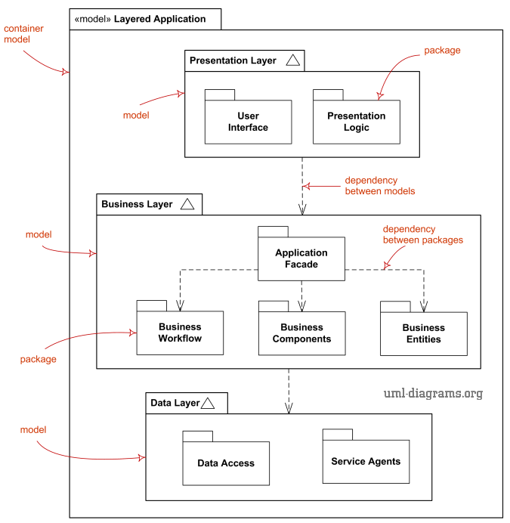
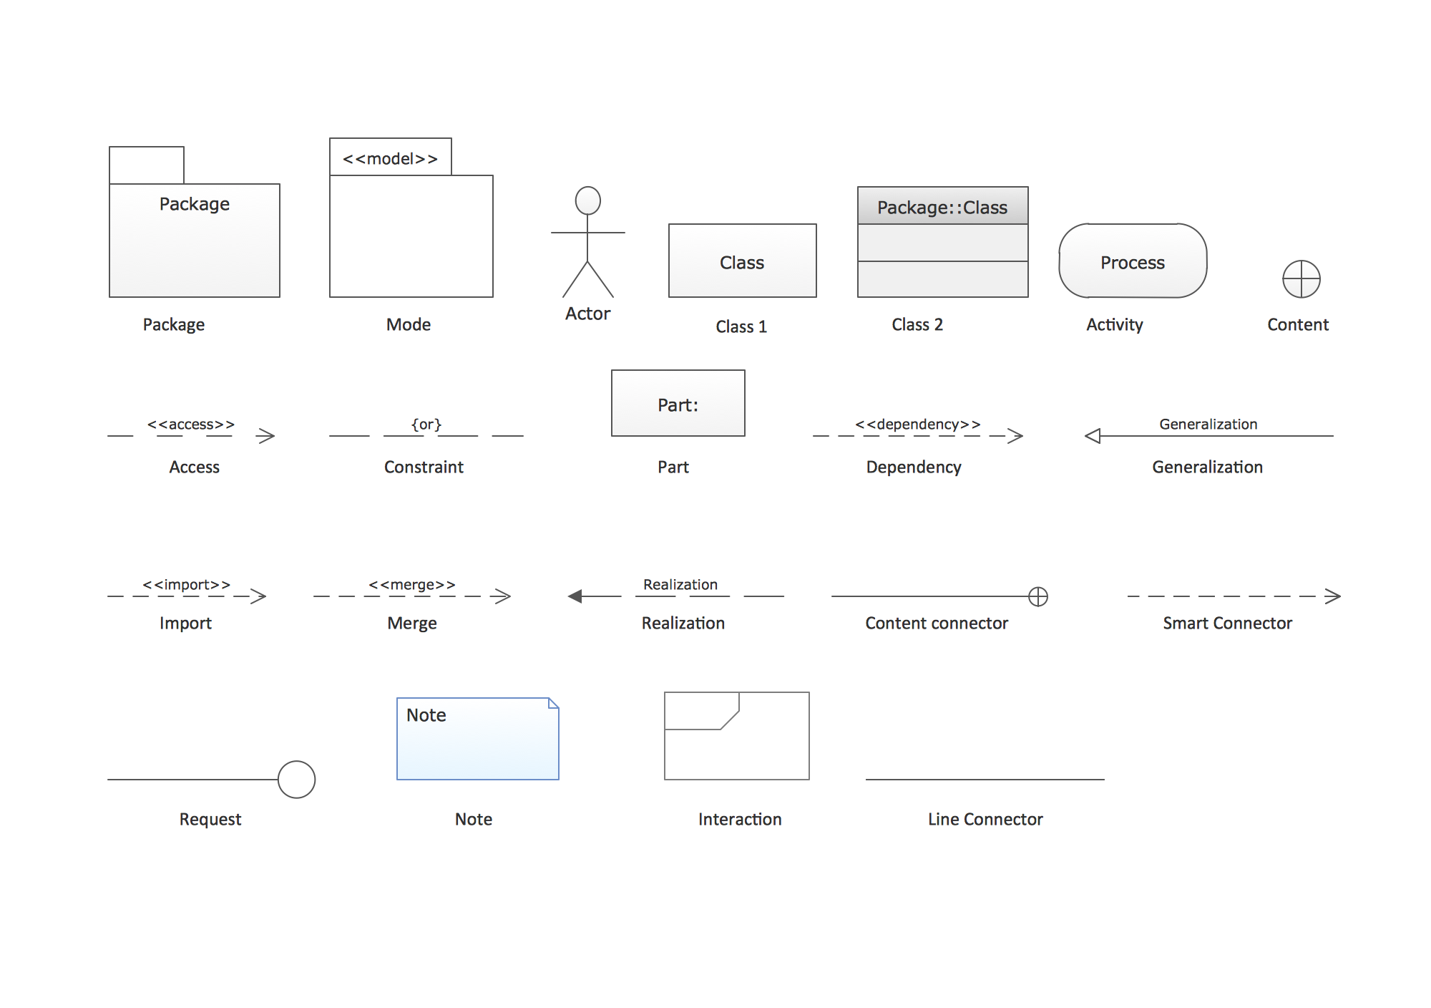

Slide 50
Part 2 – Software Modeling
Software Modeling and Design is the process of creating visual representations of a software system to understand and communicate its design, structure, and behavior.
The main goal of software modeling and design is to simplify complex software systems and make them easier to develop, maintain, and modify.
Software modeling can be considered from different perspectives, which are referred to as different views.
Use case view
Static view
Dynamic interaction view
Finite state machines and state charts
State-dependent dynamic interaction modeling
Deployment view

Slide 51
Dynamic Interaction model
Dynamic Interaction Model is a modeling technique used to represent the dynamic behavior of a system over time. It is typically used to model complex software systems and is a graphical representation of the interactions between objects in a system.
The UML Dynamic Interaction Model includes several types of diagrams, including sequence diagrams, communication diagrams, timing diagrams, and interaction overview diagrams.

Slide 52
Dynamic Interaction model
UML dynamic interaction diagrams include the following types:
Sequence Diagrams: Sequence diagrams show the interactions between objects in a system over time, with a focus on the sequence of messages exchanged between the objects. They are used to model the behavior of an individual use case or scenario.
Communication Diagrams: Communication diagrams, also known as collaboration diagrams, show the interactions between objects in a system from a structural perspective. They emphasize the relationships between objects and the messages exchanged between them, rather than the sequence of the messages.

Slide 53
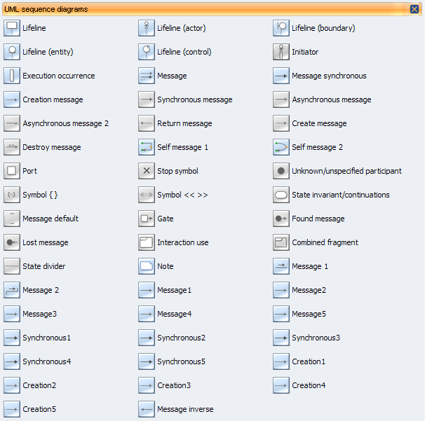
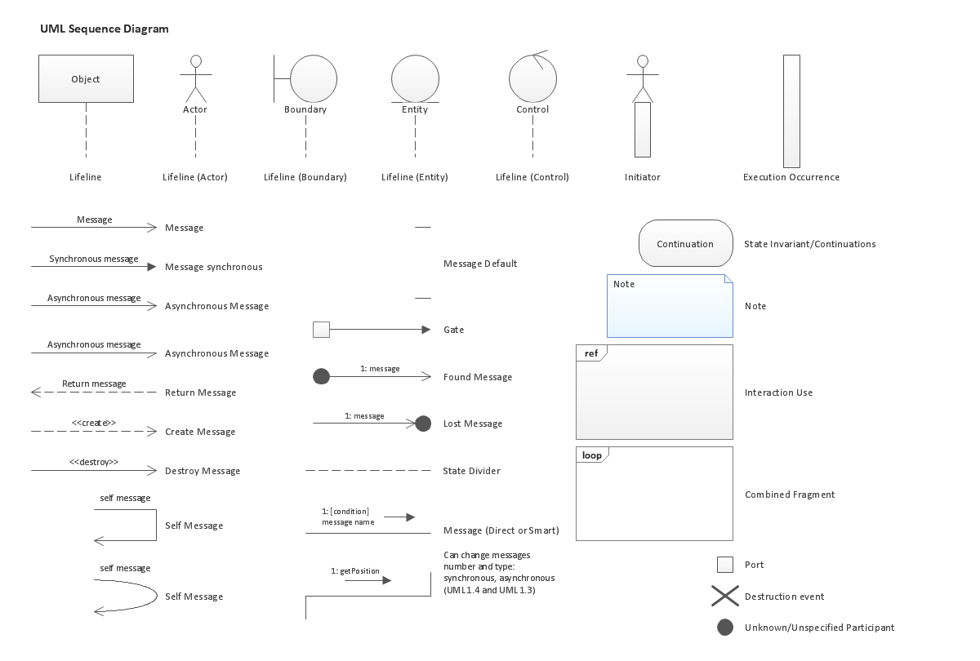
Sequence Diagram Notations

Slide 54
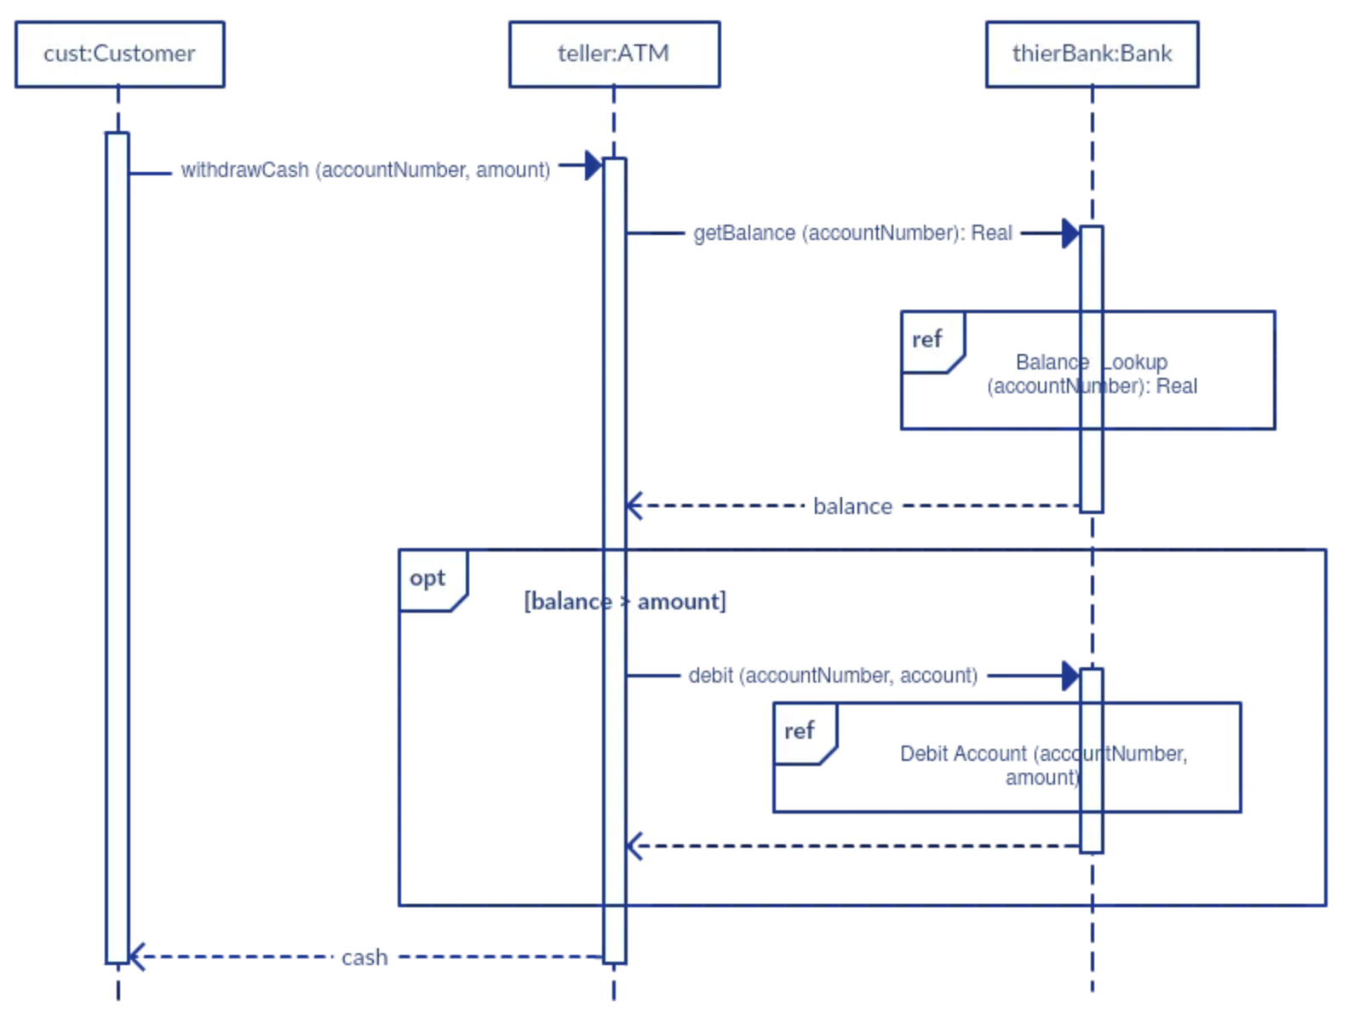
Sequence Diagram
Read >> https://creately.com/guides/sequence-diagram-tutorial/

Slide 55
UML Activity Diagram
Activity Diagram is a graphical representation of a system's workflow or business processes.
It is a type of behavioral diagram that shows the flow of activities or actions within a system, including the inputs, outputs, and conditions that affect the sequence of those activities.
Activity diagrams are particularly useful for modeling complex workflows, such as those found in software development, business processes, and engineering systems.
They provide a visual representation of the steps involved in a process, as well as the relationships between those steps and the conditions that affect their execution.

Slide 56

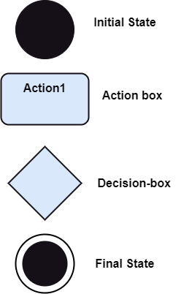
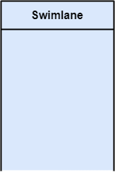
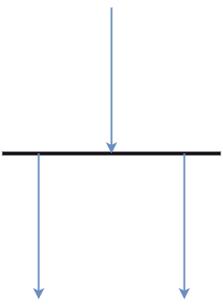
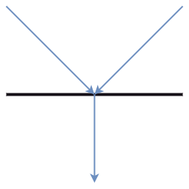
Components/Notation of an Activity Diagram
Following are the component of an activity diagram
Activities
Activity partition /swimlane:The swimlane is used to cluster all the related activities in one column or one row. It can be either vertical or horizontal
Forks: Forks and join nodes generate the concurrent flow inside the activity.
Join Nodes

Slide 57
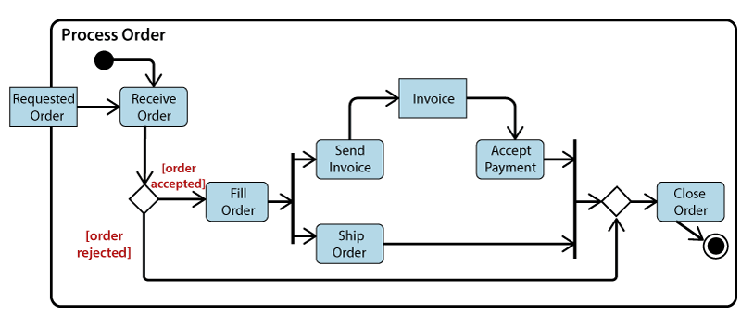
Example of an Activity Diagram: Order processing

Slide 58
When to use an Activity Diagram?
To graphically model the workflow in an easier and understandable way.
To model the execution flow among several activities.
To model comprehensive information of a function or an algorithm employed within the system.
To model the business process and its workflow.
To envision the dynamic aspect of a system.
To generate the top-level flowcharts for representing the workflow of an application.
To represent a high-level view of a distributed or an object-oriented system.

Slide 59
Finite state machines and state charts
The finite state machine diagram is also called the State chart or State Transition diagram, which shows the order of states undergone by an object within the system. It captures the software system's behavior.
Transitions between states are triggered by events or inputs and can be conditional or unconditional.
When a transition occurs, the system moves from one state to another, changing its behavior or output accordingly.

Slide 60
State machines
State machines can be described using a variety of notations, including state transition diagrams, state tables, and statecharts.
State transition diagrams are a graphical notation that shows the states of the system as nodes, and the transitions between those states as directed edges.
State tables are a tabular notation that shows the same information in a more concise form,
while statecharts are a more expressive notation that allows for hierarchical states and concurrent behaviors.

Slide 61
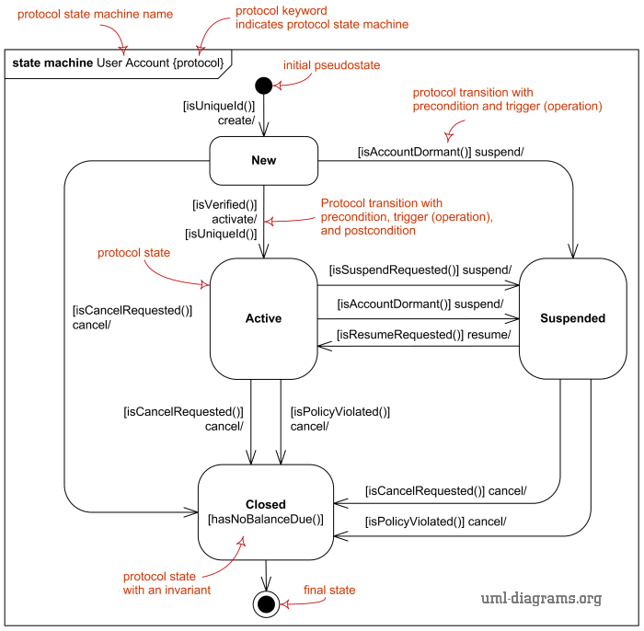
State Machines
State machines are used in a wide range of applications, including software engineering, control systems, and telecommunications.
They are particularly useful for modeling systems with complex, non-linear behaviors, and can be used to verify the correctness of a system's operation by analyzing the behavior of the state machine under various conditions.

Slide 62
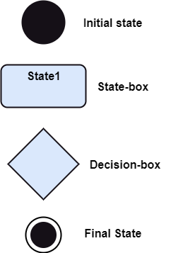
Notation of a State Machine Diagram
Initial state: It defines the initial state (beginning) of a system, and it is represented by a black filled circle.
Final state: It represents the final state (end) of a system. It is denoted by a filled circle present within a circle.
Decision box: It is of diamond shape that represents the decisions to be made on the basis of an evaluated guard.
Transition: A change of control from one state to another. It is represented by an arrow labeled with an event due to which the change has ensued.
State box: It depicts the conditions or circumstances of a particular object of a class at a specific point of time. A rectangle with round corners is used to represent the state box.

Slide 63
Types of State
The UML consist of three states:
Simple state: It does not constitute any substructure.
Composite state: It consists of nested states (substates), such that it does not contain more than one initial state and one final state. It can be nested to any level.
Submachine state: The submachine state is semantically identical to the composite state, but it can be reused.

Slide 64
Example of a State Machine Diagram
An example of a top-level state machine diagram showing Bank Automated Teller Machine (ATM) is given below.
Initially, the ATM is turned off. After the power supply is turned on, the ATM starts performing the startup action and enters into the Self Test state. If the test fails, the ATM will enter into the Out Of Service state, or it will undergo a triggerless transition to the Idle state. This is the state where the customer waits for the interaction.
Whenever the customer inserts the bank or credit card in the ATM's card reader, the ATM state changes from Idle to Serving Customer, the entry action readCard is performed after entering into Serving Customer state. Since the customer can cancel the transaction at any instant, so the transition from Serving Customer state back to the Idle state could be triggered by cancel event.

Slide 65
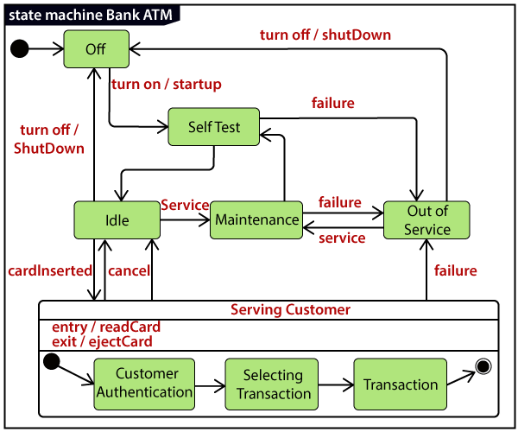
Example of a State Machine Diagram

Slide 66
State-dependent dynamic interaction modeling
State-dependent dynamic interaction modeling is a statistical modeling technique used to analyze complex systems, in which the interactions between individual components change over time, and depend on the system’s current state.
This approach involves modeling the dynamic relationships between the components of a system as they evolve over time, taking into account the system’s current state at each time point.
State-dependent dynamic interaction modeling can be used in a wide range of applications, including finance, engineering, biology, and social sciences.
For example, it can be used to model the interactions between financial markets, the behavior of cells in a biological system, or the spread of a disease in a population.

Slide 67
State-dependent dynamic interaction modeling (Cont’d)
The technique typically involves using time-series data to estimate a set of dynamic models that capture the behavior of the system over time.
These models can then be used to simulate the behavior of the system under different conditions, allowing researchers to explore how changes in the system's state affect the interactions between its components.
State-dependent dynamic interaction modeling is a powerful tool for understanding complex systems, but it can be computationally intensive and requires careful attention to model selection and parameter estimation.

Slide 68
Deployment Modeling
Deployment modeling is the process of creating a representation of the deployment model for an application or service.
It involves designing and defining the infrastructure, processes, and procedures required to deploy and manage the application in a production environment.
The deployment model provides a blueprint for the deployment process, including the necessary steps, tools, and configurations required to deploy the application or service.

Slide 69
Deployment Modeling Steps
Define the requirements: This involves identifying the business and technical requirements for the application or service. This includes determining the performance, security, scalability, and availability requirements.
Design the infrastructure: This involves designing the hardware and software infrastructure required to deploy the application or service. This includes selecting the appropriate servers, storage, networking, and security components.

Slide 70
Deployment Modeling Steps (Cont’d)
Define the deployment process: This involves defining the deployment process, including the steps, tools, and configurations required to deploy the application or service. This may include scripting or automating the deployment process using tools like Ansible, Chef, or Puppet.
Test the deployment model: This involves testing the deployment model, to ensure that it meets the business and technical requirements. This includes testing the application or service under various load and stress conditions.

Slide 71
Deployment Modeling Steps (Cont’d)
Deploy the application: This involves deploying the application or service to the production environment. This may involve deploying the application or service to a staging environment first to test it before deploying it to the production environment.
Deployment modeling is an essential part of the software development life cycle, as it ensures that the application or service is deployed and managed efficiently and effectively in a production environment. It helps to reduce the risk of downtime, errors, and security breaches and ensures that the application or service meets the business and technical requirements.

Slide 72
Deployment models
On-premises deployment: In this model, the software application or service is deployed on the company's own servers or data center.
Cloud deployment: This model involves deploying the application or service on a cloud infrastructure such as Amazon Web Services, Microsoft Azure, or Google Cloud Platform.
Hybrid deployment: This is a combination of on-premises and cloud deployment, where some parts of the application are deployed on the company's own servers and others on a cloud infrastructure.
Edge deployment: In this model, the application or service is deployed on edge devices such as routers, switches, and gateways, which are closer to the end-users.
Container deployment: This model involves packaging the application or service into containers such as Docker and deploying them on a container orchestration platform like Kubernetes.

Slide 73
Exercise 1. Class Diagram
Consider a simple banking system. The system has customers who have accounts with the bank. Each account has a unique account number, a balance, and a type (such as savings, checking, or money market). Customers can have multiple accounts with the bank. Customers can also transfer money between their accounts and view their account balances. Bank employees can view customer account information and create new accounts.

Slide 74
Exercise 2. Class Diagram
Choose one of the following class groups. Prepare a class diagram for each class group showing the relationships among the classes within each group. Include associations, aggregation, composition and generalization (inheritance). Show multiplicity. You need not show attributes or behaviors. Use association names where needed. Feel free to add additional classes.
a. school, playground, principle, school board, classroom, book, student, teacher, cafeteria, rest room, computer, desk, chair, ruler, door, swing
b. castle, moat, drawbridge, tower, ghost, stairs, dungeon, floor, corridor, room, window, stone, lord, lady, cook
c. sink, freezer, refrigerator, table, light, switch, window, smoke alarm, burglar alarm, cabinet, bread, cheese, ice, door, kitchen
d. student, quiz, exam, professor, department head, undergraduate course, degree, university, classroom, building, teaching assistant, graduate course, dean, committee, department, school catalog.

Slide 75
Exercise 3. Sequence Diagram. Simple e-commerce website
Consider a simple e-commerce website. When a customer places an order on the website, the system needs to perform several tasks, including verifying the customer's payment information, updating the inventory, and sending a confirmation email to the customer.
Solution:
The sequence diagram for the e-commerce system can include the following steps:
The customer places an order on the website by selecting items and entering payment information.
The system verifies the customer's payment information and sends a request to the payment gateway.
The payment gateway processes the payment and sends a response to the system.
The system updates the inventory by reducing the quantity of items in stock.
The system sends a confirmation email to the customer.
Design a sequence diagram for this e-commerce system.

Slide 76
Exercise 4. Activity Diagram. Room Booking
Booking a Room in a hotel When customer requests a room, the hotel employee looks for room availability, then he insert customer’s data and verifies if the provided credit card number has enough credit to pay the room: in this case the booking is confirmed and we wait customer arrival.
The Hotel information system allows customer to modify or cancel his/her reservation. If customer arrives he uses the room and then he pays, in case of no-show a penalty is accounted on his credit card and the booking is canceled.

Slide 77
Exercise 5. Activity Diagram. Voting System
Once arrived at the polling station, elector gives the own electoral card to station president who checks if the polling station number is right . Then he checks the identity document and if ok he gives the ballot paper to the elector.
Then the president waits for a cabin to get free and he gives the pencil to the elector and a secretary who signs the registry and put a print on the elector certificate. Once elector has voted, he/she inserts the ballot paper in the urn, giving back the pencil and taking back the own ID document.

Slide 78
Exercise 6. Statechart
Consider a vending machine that sells snacks and drinks. The vending machine has three states: idle, waiting for payment, and dispensing. When the vending machine is in the idle state, customers can select a product to purchase. When a product is selected, the vending machine transitions to the waiting for payment state, where it waits for the customer to insert payment.
If the payment is accepted, the vending machine transitions to the dispensing state, where it dispenses the product and returns any change. After dispensing the product, the vending machine returns to the idle state.
If the payment is rejected the vending machine returns any coins inserted
When the vending machine has run out of the selected product, the state will transition to Out of stock

